Slide 1


KNOCK-KNOCK
A deep learning powered door camera
Steven Leung
Juan Ramirez
Javed Roshan
W251 Final Project Presentation
Notes:
Juan

Slide 2
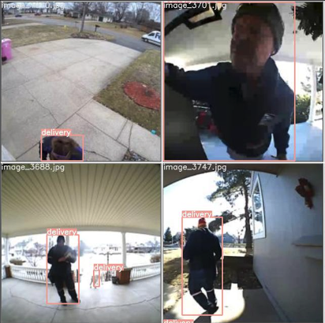
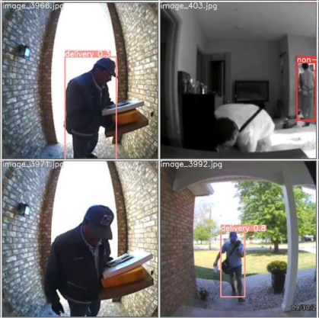
Why Knock-Knock?
The door camera market size reached $1.83B in 2020 (16% US households)¹
Knock-knock is a novel door camera that recognizes common personnel at the door and notifies user:
Facial Recognition to identify known individuals
Full body recognition to identify delivery vs non-delivery personnel
Notes:
Juan
Define business problem that we are solving.

Slide 3
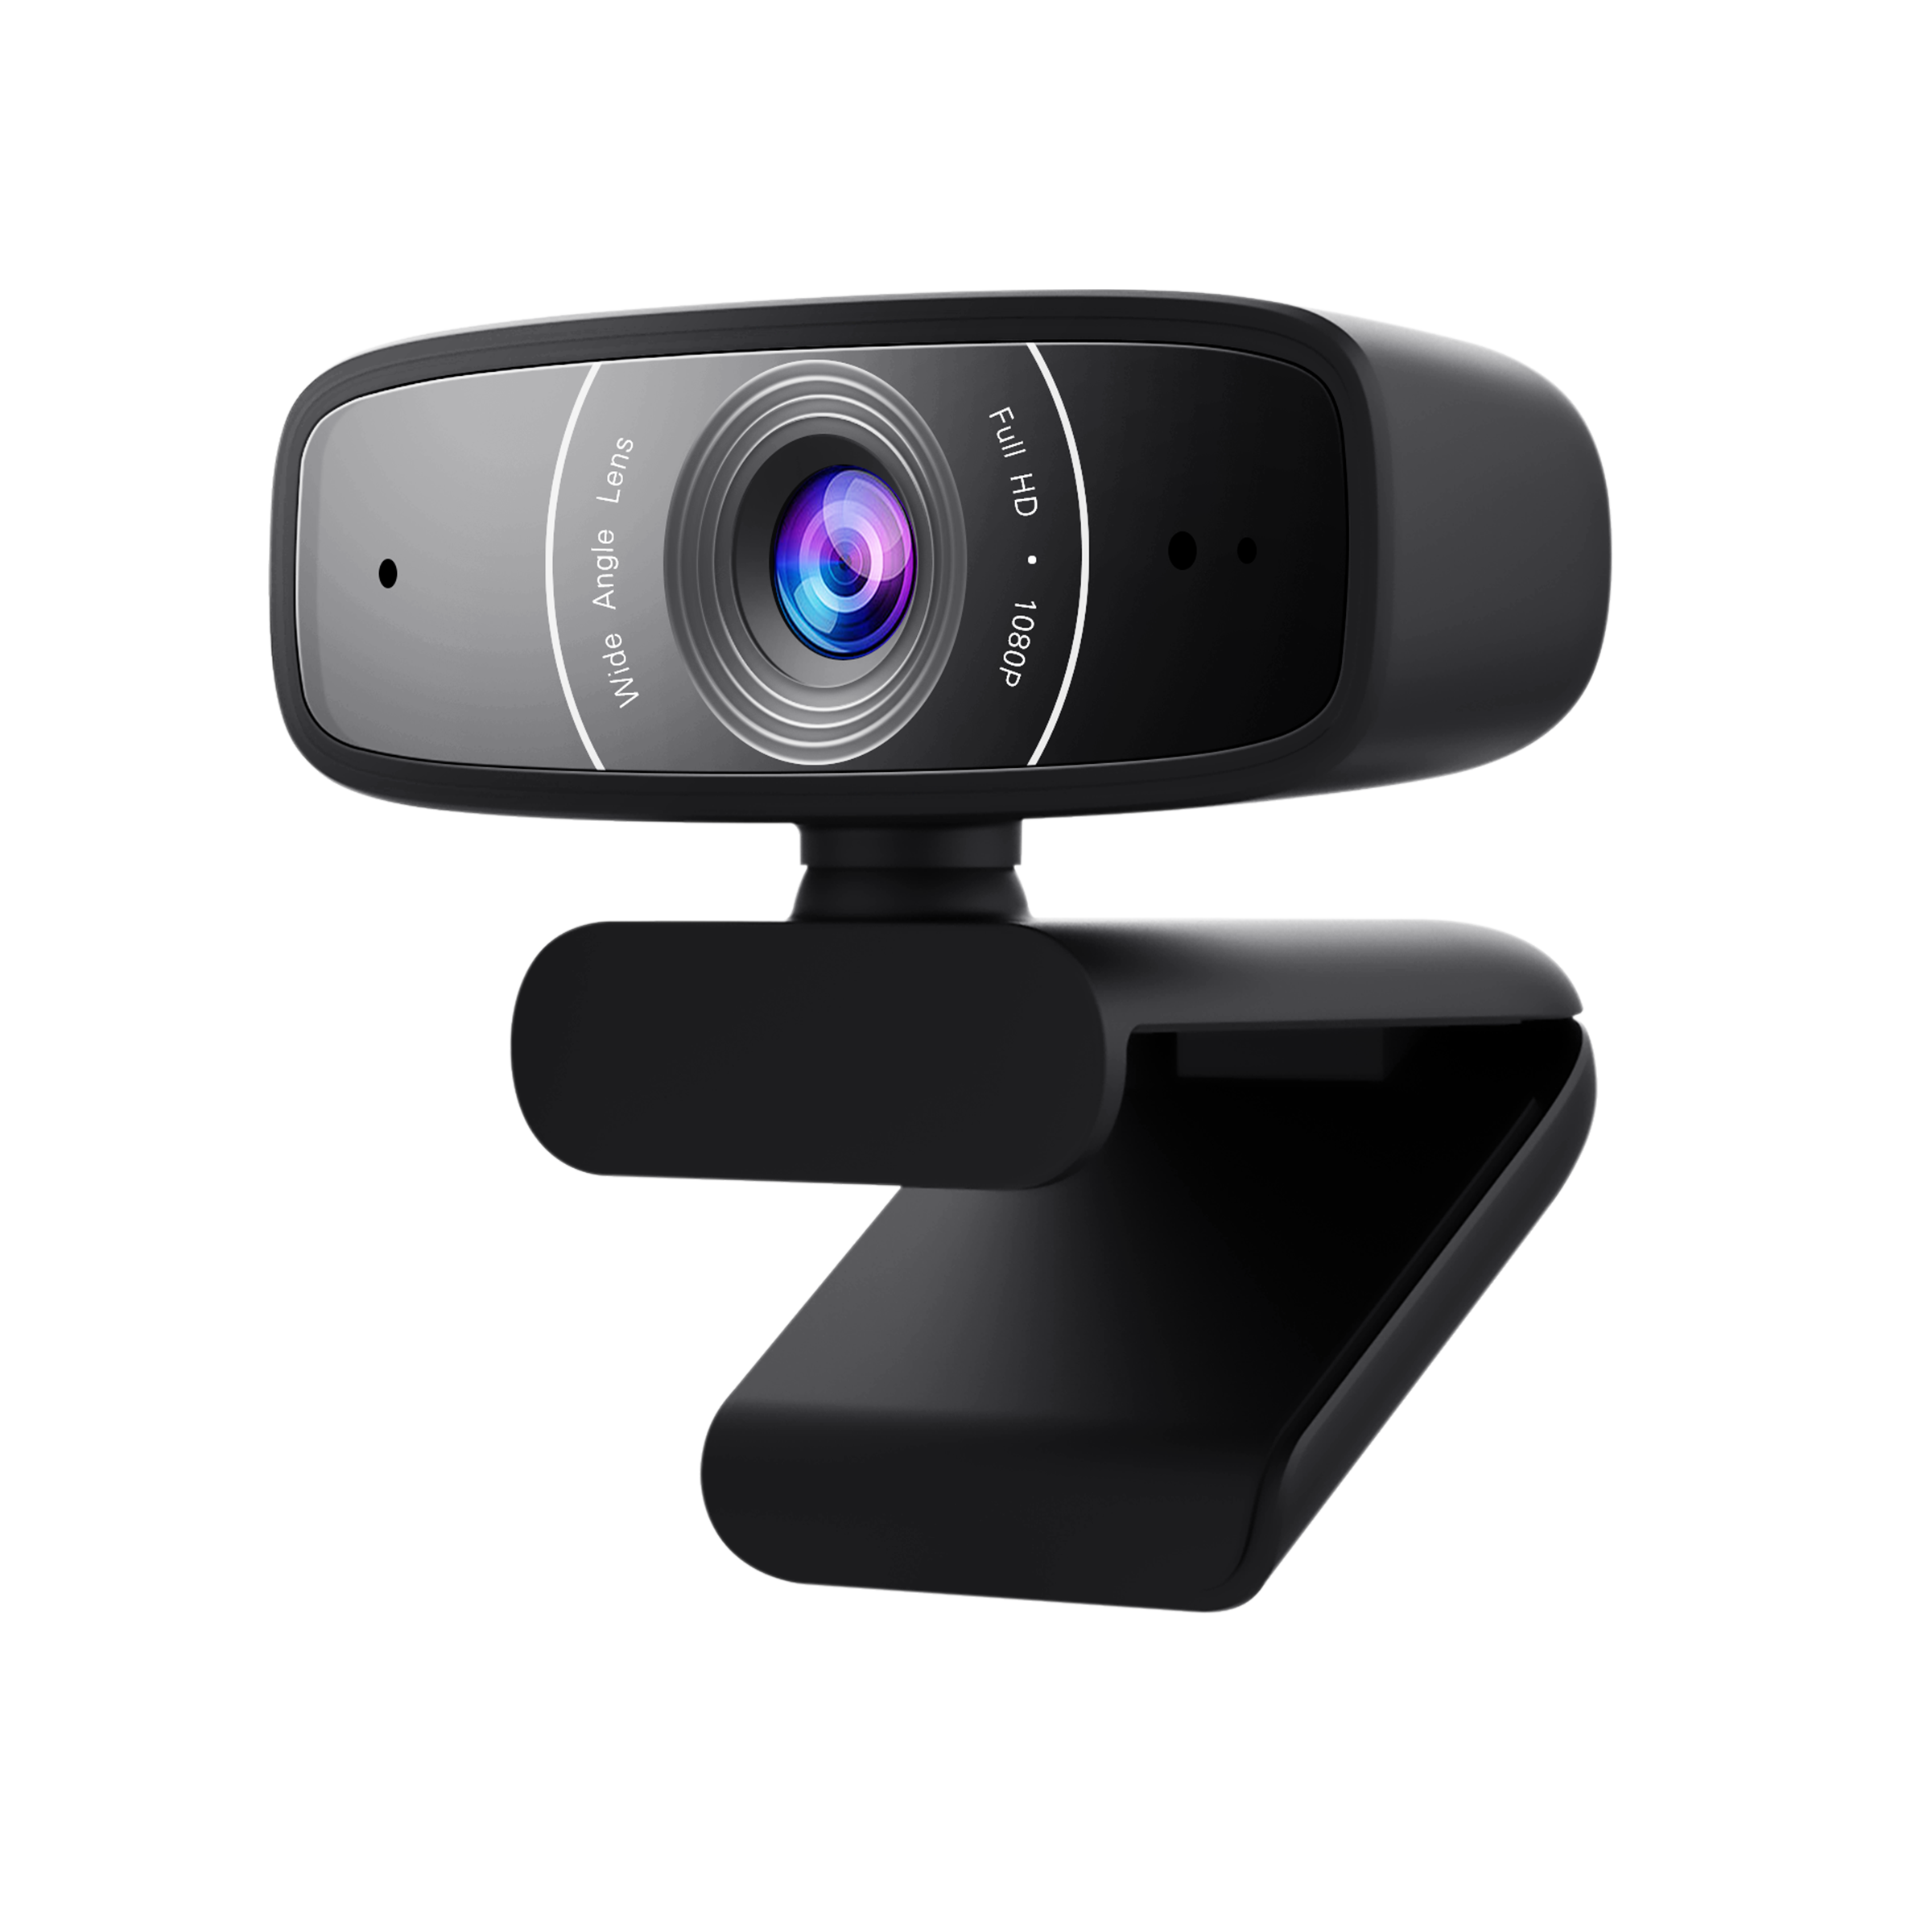
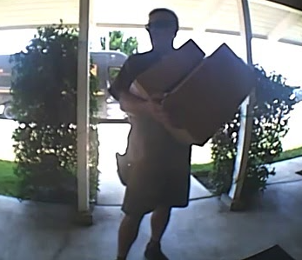
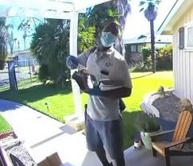
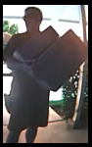

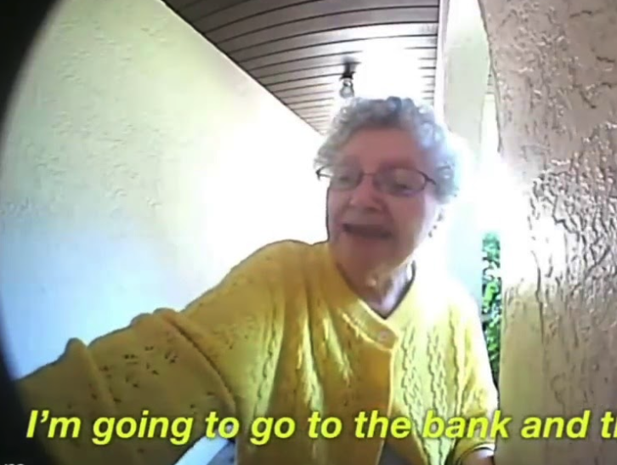
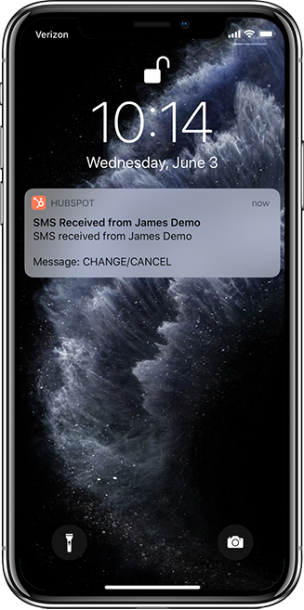
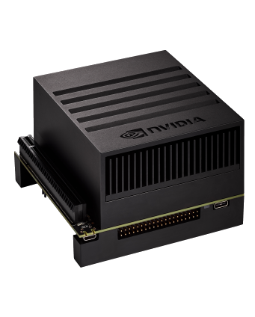

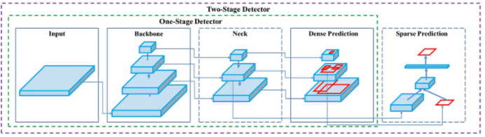
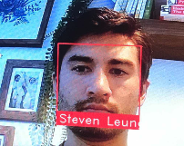
Data Pipeline
Image Collection Youtube to Images
Video Stream
Annotation Deep Lab Segmentation
Person Recognition
Fine tune Yolov5
Delivery Non-Delivery (DND) Recognition
Jetson Xavier NX
SMS Notification
Facial Recognition
Facial Recognition
Dlib Face-Recognition
Notes:
Steven
Dual functionality of knock-knock = two models
First is DND
TO mirror most closely to the production environment, we used door camera vids from creative commons license on youtube
Two sets of search queries- this plus manual review allowed us to label d vs nd
Extracted image 1 fps
Annotation of person in video we used deep lab segmentation- covert to yolo friendly format
Around 10k images annotated through this semi-automated method
Fine tuned yolov5s
Facial Rec
Dlib face-rec C++ model with python api. One shot model that needs a single image to provide accurate frontal recognition
With both models in jetson, live video passed to models for inference, the model outputs are combined to send notifications

Slide 4
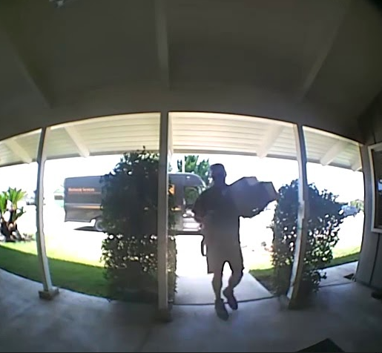
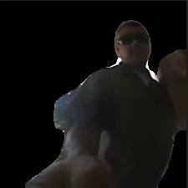

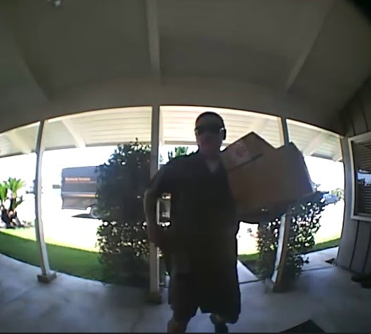

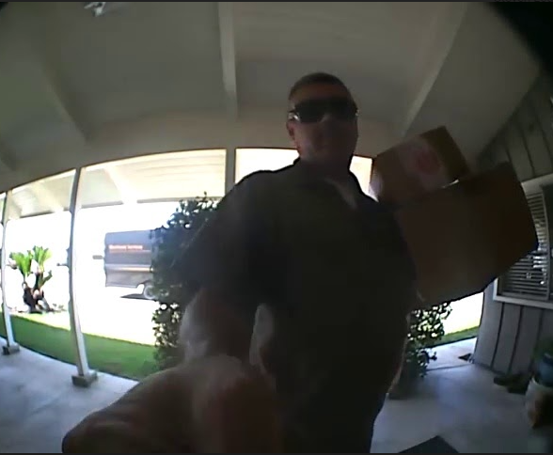
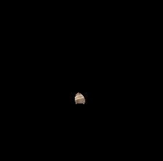

Automated Annotations- DeepLabV3 Segmentation
We used YouTube search query and DeepLab V3 (semantic segmentation) to automatically annotate 10k images from the video results.
Person identified
YouTube Query
videos
Segmented & Resized
Raw images
Discard
Notes:
Juan
Segmentation allowed us to detect if a person was in the image or not, discarding images that didn’t have people in them for our training.
If pixel area > thd save in corresponding classification folder.
Atrous convolution (dilated convolution increases the field of view)
Talk about DeepLab V3 and how it works.

Slide 5
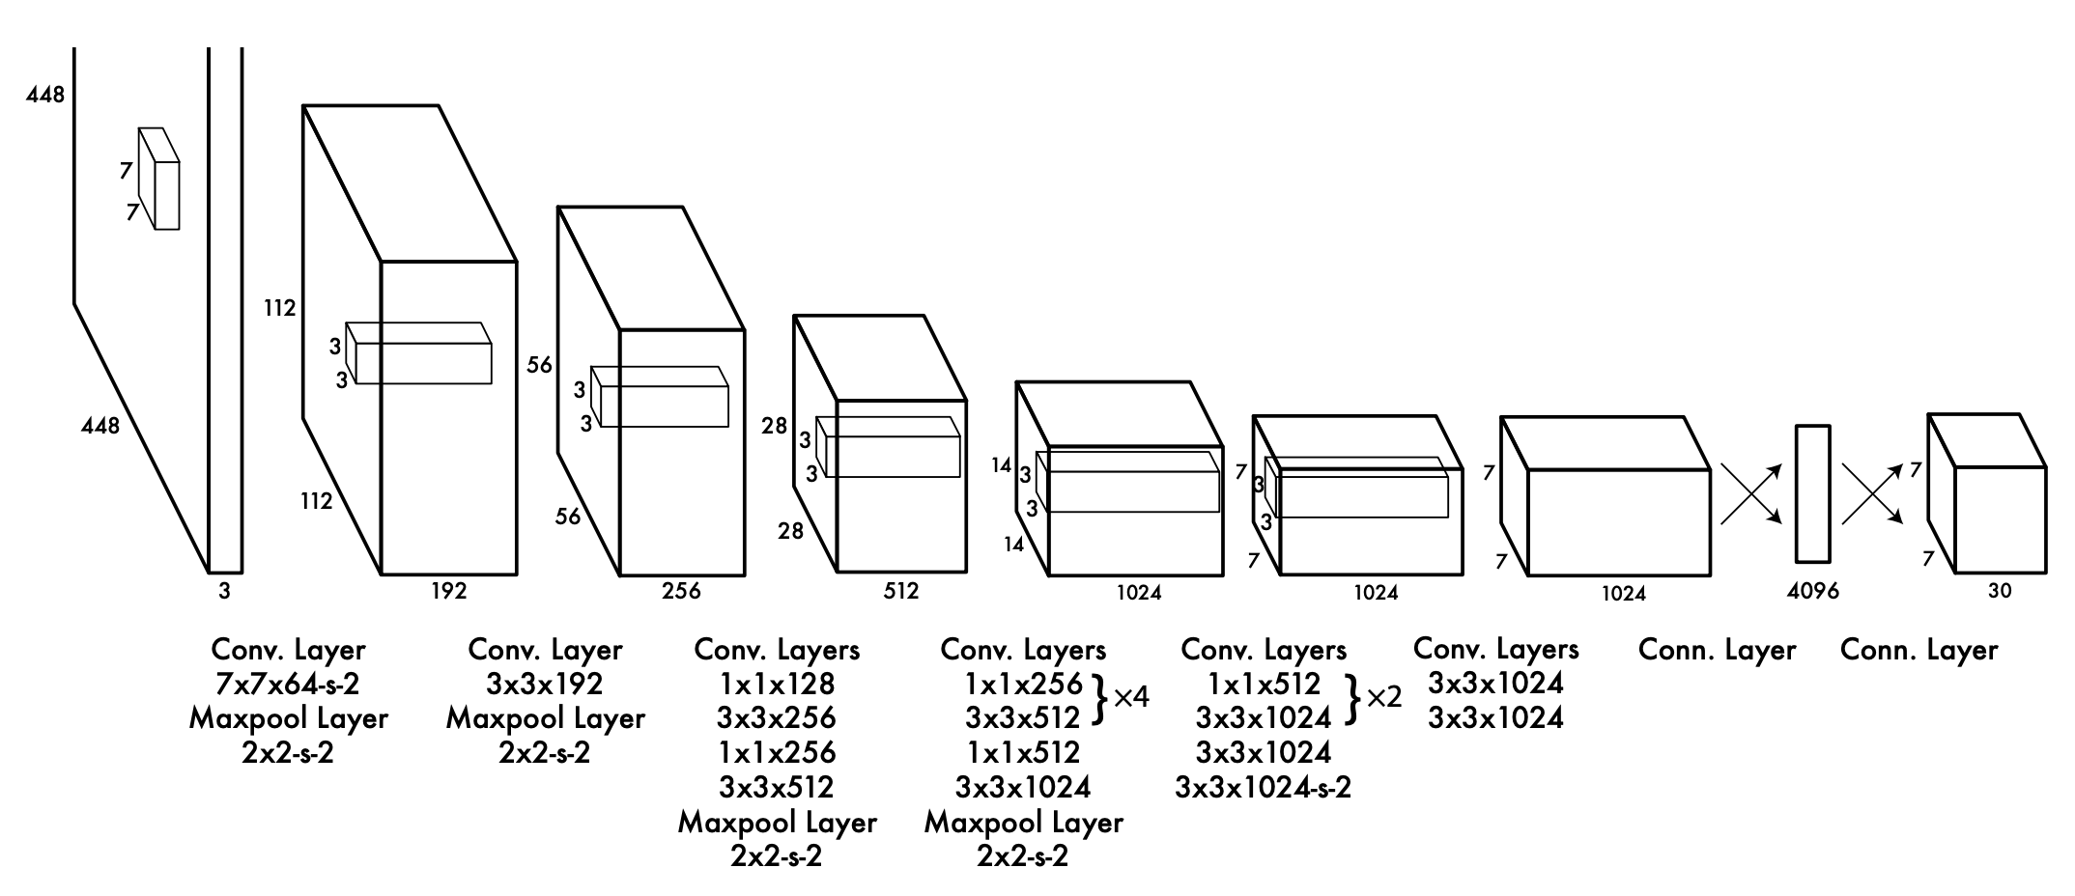
Object Detection – YOLOv5
Real Time Object Detection: You Only Look Once (YOLO)
Performance compared to other models like Faster RCNN (Resnet50 based)
52.8 FPS vs 21.7 FPS
Architecture:
24 Convolution layers with 2 FC layers
Pre-trained on COCO data
Original versions were built using Darknet framework (C based)
Yolov5 is written in PyTorch
Some controversy on the use of name / transparency
of model architecture details.
https://arxiv.org/pdf/1506.02640.pdf
Notes:
Juan

Slide 6
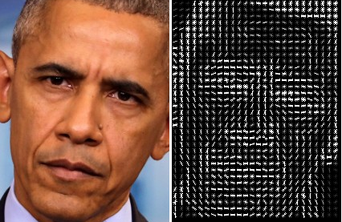
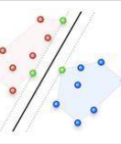
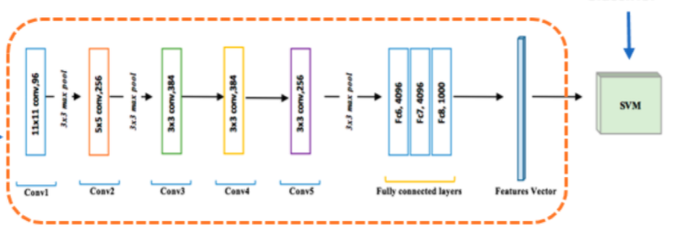
Dlib Face-Recogntion
HOG + SVM
Obama
Dlib is a popular deep learning library written in C++ with python api.
Face_recognition is a one-shot model utilizing Histogram Oriented Grandient (HOG) + Support Vector Machine (SVM) model or CNN based model
Performed at 99.38% on Labeled Faces in the Wild benchmark.
HOG
SVM
CNN
Obama
Notes:
Steven
HOG uses gradient direction of each pixel, groups them into small groups called cells. Take a histogram of each cell to reduce noise and aggregate direction over the group. Doing this for all cells give an overall structure of the image.
SVM as a classifier the seperates labels based on hyperplane
CNN has now been shown to do much of the work of HOGs and are now replacing them but still perform a bit slower.
For our use case, we chose the HOG-SVM because did not see significant difference in performance with CNN’s but may adjust with more difficult inference environment.

Slide 7
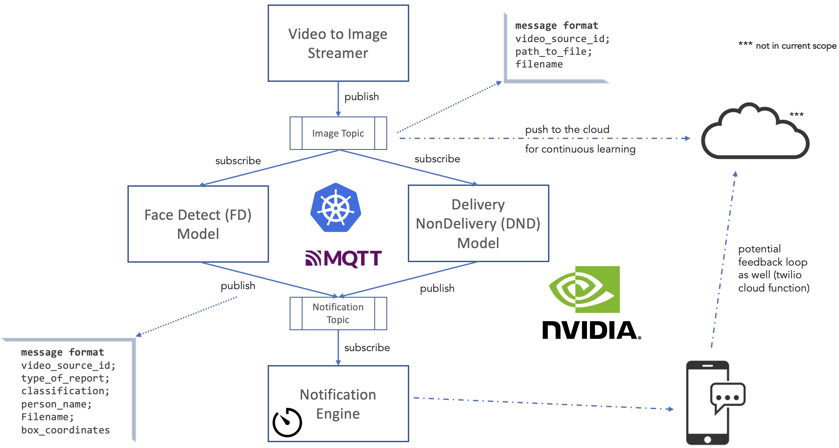
Inference Side
Notes:
Javed

Slide 8
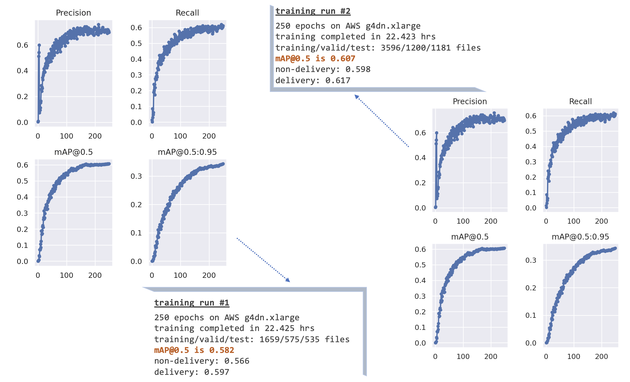
Model Performance
Notes:
Javed

Slide 9
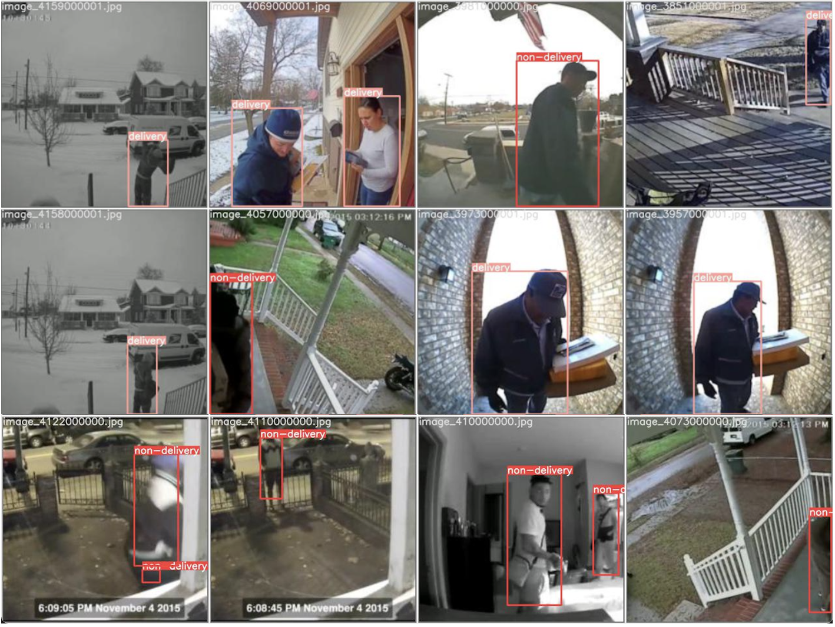
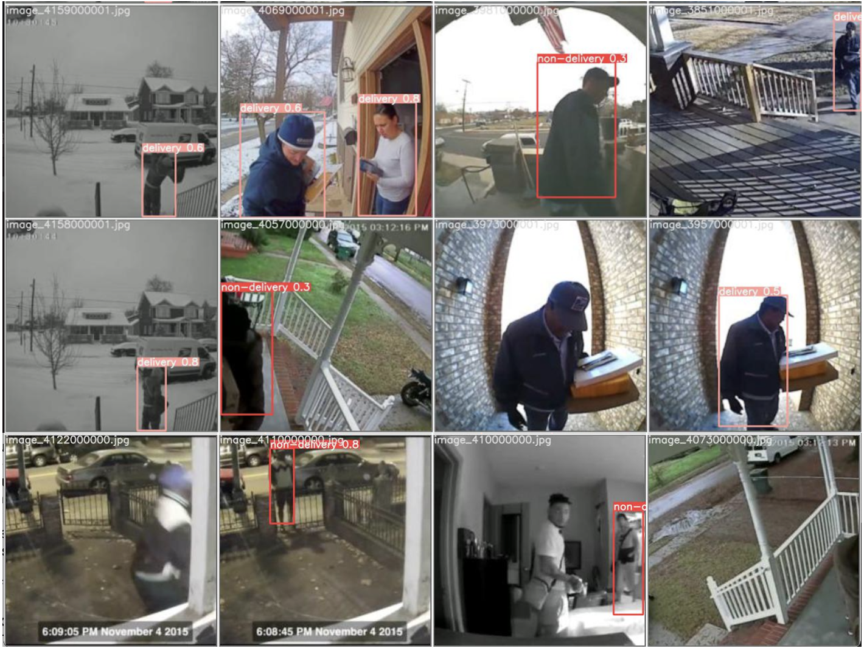
Model Performance
Labelled
Predicted
Notes:
Javed

Slide 10
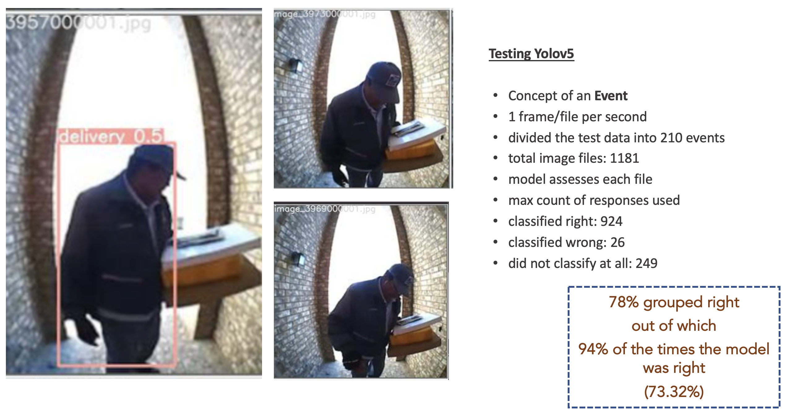
Testing w/Yolov5
Notes:
Javed

Slide 11
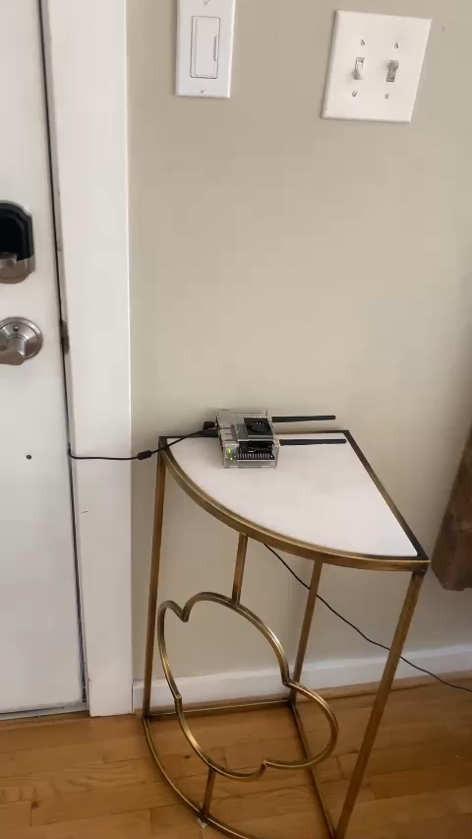
Knock-Knock in Action
Notes:
Steven

Slide 12
Challenges
YouTube queries – contained incorrect labelling and or more than one class per image adding noise into our training.
Timing & Lag – competing messages & model output synch
Notification time window logic – tuning the time window between events
Notes:
Juan
Notification logic was hard. Balancing user experience with code design. We settled deterministic but room for expansion

Slide 13
Next Steps
User Experience
Notification Enhancements
Continuous Training and Evaluation
Allow users to provider feedback on model results for continuous improvement
Summarization of actions at the door
Hardware
Notes:
Steven
Notification enhancements- single notification per event,

Slide 14
Sources
https://www.grandviewresearch.com/industry-analysis/doorbell-camera-market
https://www.cnet.com/home/security/best-facial-recognition-security-cameras/
Deep Lab Segmentation https://arxiv.org/pdf/1606.00915.pdf
Yolov5 https://zenodo.org/record/4679653#.YQlL01NKhqsDlib
face rec https://face-recognition.readthedocs.io/en/latest/readme.html

Slide 15
Fonts & colors used
This presentation has been made using the following fonts:
Share Tech
(https://fonts.google.com/specimen/Share+Tech)
Maven Pro
(https://fonts.google.com/specimen/Maven+Pro)
#002845
#e898ac
#00cfcc
#ff9973

